Slide 1
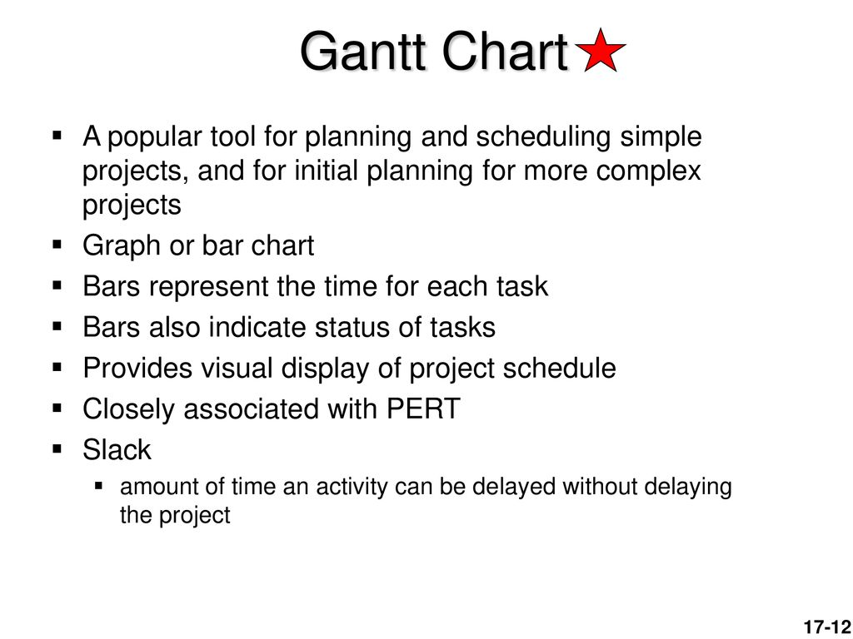

Slide 2
Draw GANTT chart for a bank
Activity | Activity ID | Predecessor | Duration in weeks
Locate new facilities | A | - | 8
Interview prospective staff | B | - | 4
Hire and train | C | B | 9
Select and order furniture | D | A | 6
Remodel and Install phones | E | A | 11
Furniture received and set up | F | D | 3
Move in | G | C, E, F, | 1
Labors
4
2
6
3
2
4
2

Slide 3
Activity ID | Predecessor | Duration in weeks
A | - | 8
B | - | 4
C | B | 9
D | A | 6
E | A | 11
F | D | 3
G | C, E, F, | 1
Activity
A
B
C
D
E
F
G
Slack 6 weeks
Slack 2 weeks
Project completion time
20 weeks
0 2 4 6 8 10 12 14 16 18 20
Critical path/ Largest path=A-E- G=20 weeks
Slack is zero for all activities on critical path
Duration in weeks

Slide 4
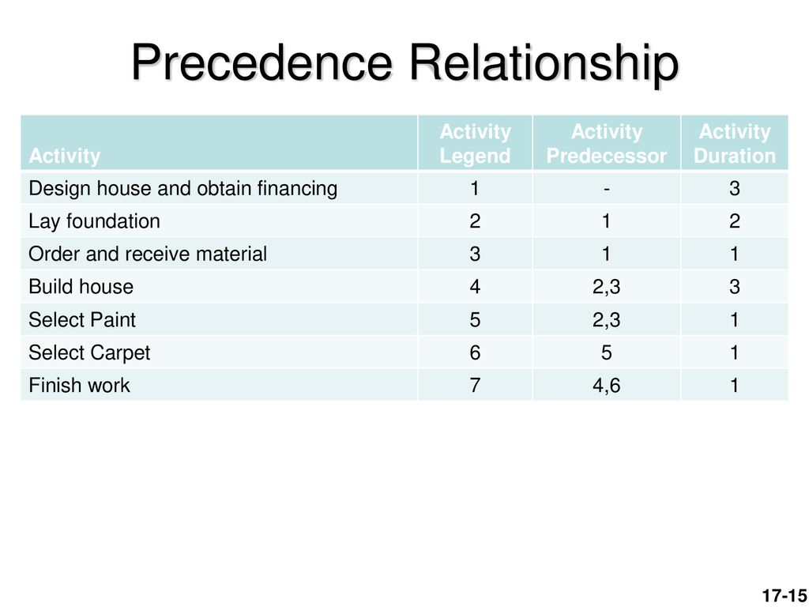
Draw GANTT chart
Month

Slide 5
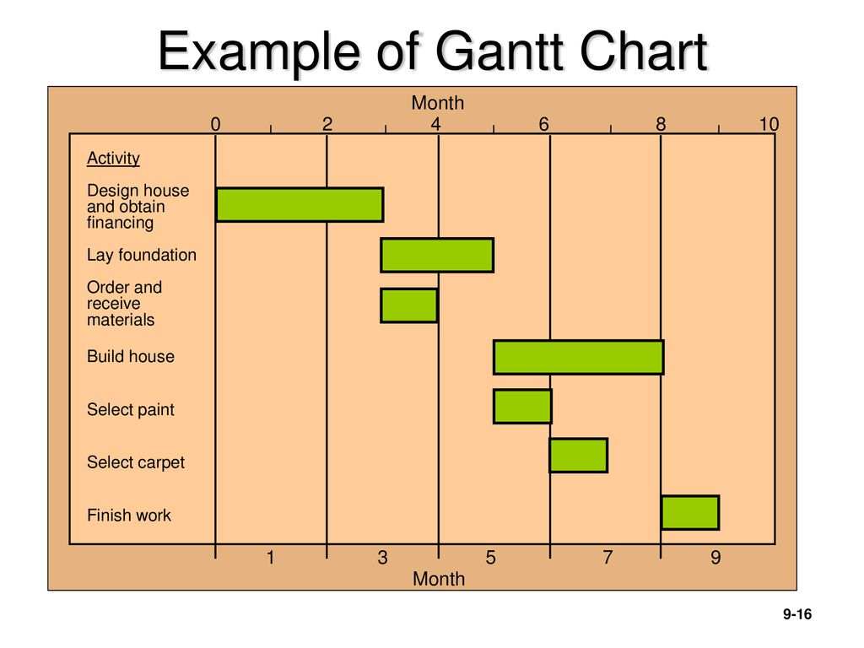
Slack I month
Slack I month
Milestone

Slide 6
Critical paths
A-C-E-END
B-H-I-END
Activity | Predecessor | Duration in days
A | _ | 5
B | _ | 8
C | A | 9
D | _ | 9
E | C | 6
F | D | 3
G | F | 4
H | B | 7
I | H | 5
End | E, G, I
Activity
Gantt Chart
A
B
C
D
E
F
G
H
I
END
Slack 4 days
Project completion time = 20 days
0 2 4 6 8 10 12 14 16 18 20 22 24
Duration in days

Slide 7
Draw Gantt Chart
Activity | Predecessor | Time in days
a | ---- | 5
c | a | 8
d | c | 2
b | a | 7
e | --- | 3
f | e | 6
i | b, d | 10
m | f, i | 8
g | --- | 1
h | g | 2
k | h | 17
end | k, m
Assignment 3

Slide 8
B
Draw Gantt chart and CPM and show the slack time.
C
Activity | Predecessor | Time in weeks
B | - | 2
I | B | 3
J | I | 4
K | J | 5
C | - | 8
M | C | 1
N | M | 7
D | N | 9
END | K, D

Slide 9
LS | Slack | LF
ES | t | EF
At starting , activity, ES=0
Forward pass
Each activity, EF=ES+t
13 | 11 | 16
2 | 3 | 5
Follower ES= Predecessor EF
t
16 | 11 | 20
5 | 4 | 9
11 | 11 | 13
0 | 2 | 2
I
3
J
B
4
20 | 11 | 25
9 | 5 | 14
2
Critical path=C-M-N-D-END=25 weeks
Project completion time =25 weeks
K
S
5
C
End
8
M
N
D
0 | 0 | 8
0 | 8 | 8
0
1
7
9
25 | 0 | 25
25 | 0 | 25
8 | 0 | 9
8 | 1 | 9
9 | 0 | 16
9 | 7 | 16
16 | 0 | 25
16 | 9 | 25
Each activity
At ending activity, LF=EF
Slack=LS-ES
Or LF-EF
Backward pass
Each activity, LS=LF - t
Predecessor LF=Follower LS

